Slide 1


Windows Azure Under the hood
Maarten Balliauw http://about.me/maartenballiauw http://blog.maartenballiauw.be @maartenballiauw

Slide 2

First of all...
Deck is based on publicly available info
I can not guarantee correctness!
Special thanks to Mark Russinovitch for a lot of content!

Slide 3




Who am I?
Maarten Balliauw
Antwerp, Belgium
www.realdolmen.com
Technology Specialist Windows Azure
Co-founder of AZUG
Focus on web
ASP.NET, ASP.NET MVC, PHP, Azure, …
MVP ASP.NET
http://blog.maartenballiauw.be
@maartenballiauw

Slide 4
Agenda
Windows Azure 101
The Fabric Controller
Deploying a service
Updating a service
Host OS upgrades
Health
Takeaways

Slide 5
Windows Azure 101
A quick introduction / recap

Slide 6
Cloud
Consumer view:
On-demand
Self-service
Pay-for-use
Scalable
+ Service provider view:
Multi-tenant
Cost-effective
What you get?
Anything the service provider has to offer!
Compute
Storage
CDN
Integration
VPN
...
➔ Resources

Slide 7

*aaS
Windows Azure
= Managed for You | Standalone Servers | IaaS | PaaS | SaaS
Applications
Runtimes
Database
Operating System
Virtualization
Server
Storage
Networking
Standardization & Efficiency
Customization & Control

Slide 8
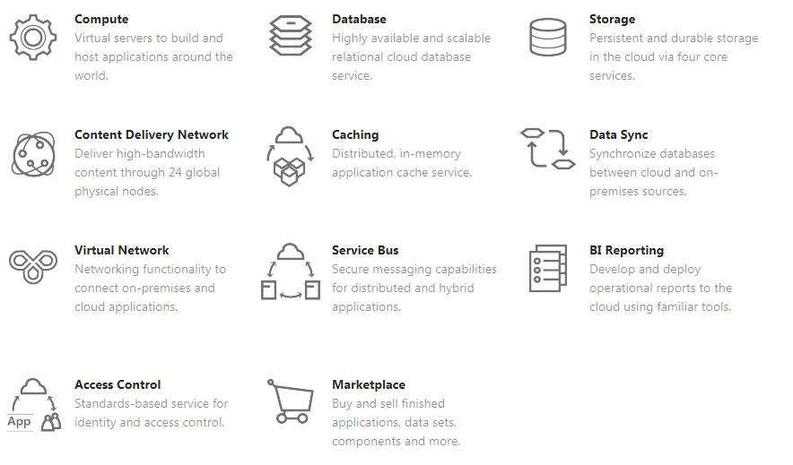
“Windows” Azure?
Stuff which is also offered by your Operating System.
Windows Azure is an Operating System - just at a larger scale...

Slide 9
Windows Azure!
Windows Azure is an OS for the data center
Takes care of the machine = data center
You concentrate on business logic
Not on fail-over clustering, provisioning, load balancing, ...
Provides shared pool of compute, disk and network
Illusion of unlimited capacity
Provides building blocks for applications

Slide 10
Core platform features
Automated OS updates & patches
Automated application updates
Automated configuration changes
Designed to scale out
Notes:
Idempotent operations (more than once)

Slide 11
Some consequences...
“Windows Azure Application Model”

Slide 12
Some consequences...
You should
Design for costs
Design for scale out (instead of scale up)
Design for failure
Idempotent operations
Short timeouts & retries
Stateless (with state on durable storage)
Come see my next session ☺
Notes:
Idempotent operations (more than once)

Slide 13
A typical Windows Azure app
Application consists of
Actual application in one or multiple roles
Role = isolation boundary (~= DLL)
Service model
ITPro-as-an-XML
Configuration

Slide 14
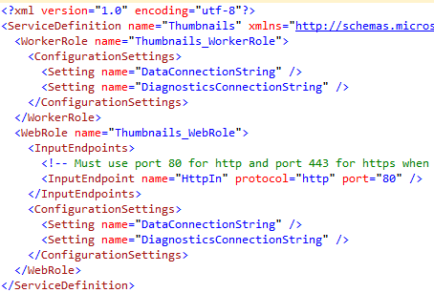
ServiceDefinition.csdef
Defines
Which roles there are
Role names & types
VM size (x-small, small, medium, ...)
Network endpoints required
What configuration values to expect
# update domains
Can not be changed for a deployment

Slide 15
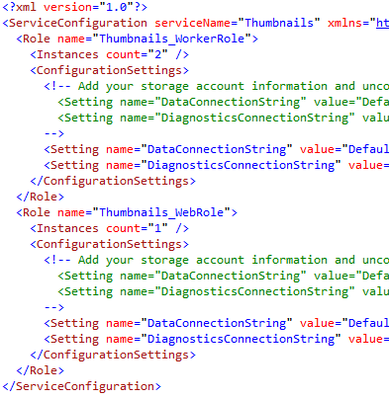
ServiceConfiguration.cscfg
Contains
# instances
Configuration values
Certificates
…
Can be changed at runtime

Slide 16
Update Domains
Front-End-1
Middle Tier-3
Middle Tier-1
Front-End-2
Middle Tier-2
Ensure service stays up during updates
Update domains = percentage of service that will be offline
Default and max is 5
Can be overridden
Front-End-1
Front-End-2
Middle Tier-1
Middle Tier-2
Middle Tier-3
Update Domain 1
Update Domain 2
Update Domain 3

Slide 17
Fault Domains
Similar to upgrade domains
“Unit of failure”
Considered by WA when provisioning
>= 2 fault domains per service
Front-End-1
Front-End-2
Middle Tier-1
Middle Tier-2
Middle Tier-3
Fault Domain 1
(eg 1 rack)
Fault Domain 2
(eg 1 rack)
Fault Domain 3
(eg 1 rack)

Slide 18


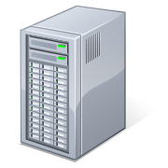

High-level: deploying a service
Service
Service
Service
Model
Your
Service
DNS
LB
Web Portal
(API)
DNS
config
Fabric
Controller
LB

Slide 19
The Fabric Controller
Windows Azure’s kernel

Slide 20
Kernel?
Windows Azure kernel
Manages hardware & services
Uses description of hardware & network resources it will control
Service model and binaries for applications
Responsibilities
Resource allocation
Resource provisioning
Service lifecycle & health management
Word
SQL Server
Your App #1
Your App #2
Windows Kernel
Fabric Controller
Server
Datacenter

Slide 21
Datacenter architecture
Datacenter Routers
Aggregation Routers and
Load Balancers
Agg
Agg
Agg
Agg
LB
LB
LB
LB
LB
LB
LB
LB
Top of Rack
Switches
TOR
TOR
TOR
TOR
TOR
TOR
TOR
TOR
TOR
TOR
TOR
TOR
Racks
Nodes
Nodes
…
Nodes
Nodes
…
…
…
Nodes
Nodes
Nodes
Nodes
Nodes
Nodes
Nodes
Nodes
PDU
PDU
PDU
PDU
PDU
PDU
PDU
PDU
PDU
PDU
PDU
PDU
Power Distribution Units
Notes:
40 blades in a rack
Top router is SPOF
Top switch is SPOF
Fault-domain: rack!

Slide 22
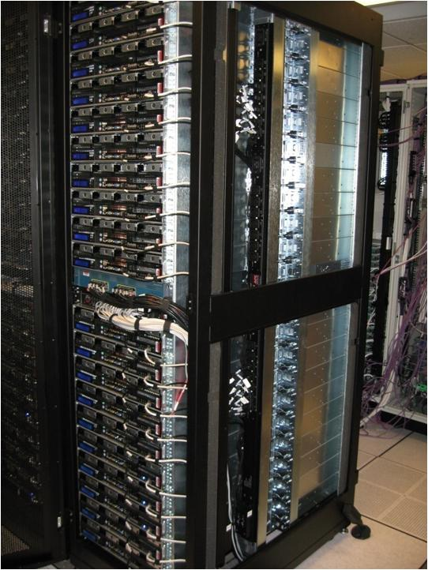
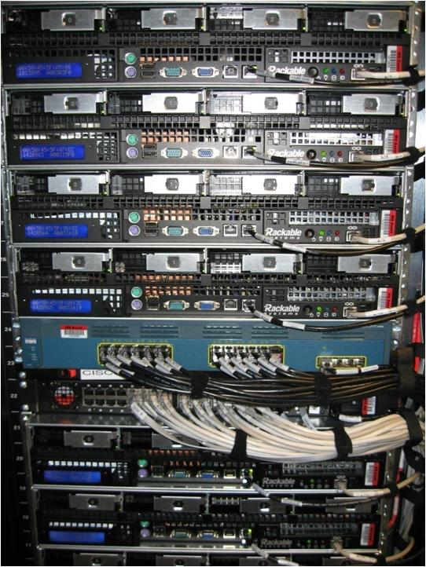
Sample rack architecture

Slide 23
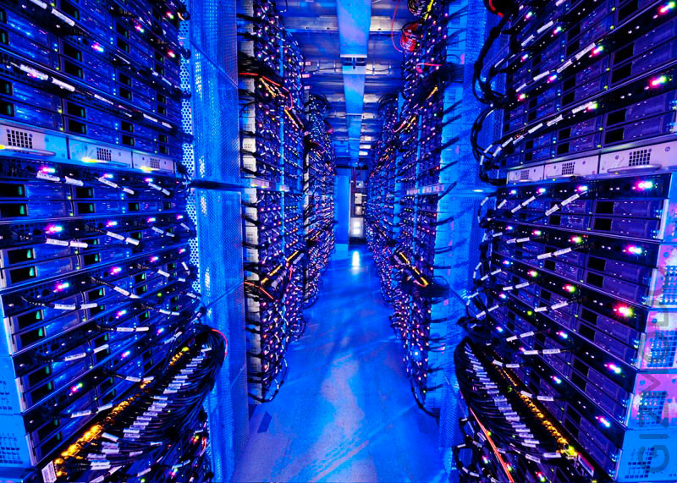

Slide 24
High-Level FC Architecture
Distributed application running on nodes spread across fault domains
Installed by “Utility” FC
One primary FC
Supports rolling upgrade
If FC fails, your apps are unaffected
LB
AGG
LB
LB
LB
LB
TOR
TOR
TOR
TOR
TOR
FC1
FC2
FC3
Nodes
FC3
FC4
FC5
…
…
…
…
…
…
…
…
…
…
Rack

Slide 25
Provisioning a Node
Fabric Controller
Image Repository
Power on node
Network (PXE) boot of Maintenance OS (WinPE)
Agent formats disk & downloads Host OS
Host OS boots, runs Sysprep & reboots
FC connects with the Host Agent
Maintenance OS
Windows Azure
OS
PXE
Server
Maintenance OS
Parent
OS
Role
Images
Role
Images
Role
Images
Role
Images
Node
Windows
Azure
OS
FC Host Agent
Windows Azure Hypervisor

Slide 26
Inside a Node
Physical Node
Guest Partition
Guest Partition
Guest Partition
Guest Partition
Role Instance
Role Instance
Role Instance
Role Instance
Guest Agent
Guest Agent
Guest Agent
Guest Agent
Trust boundary
Host Partition
FC Host Agent
(trusted)
Fabric Controller (Primary)
Fabric Controller (Replica)
Fabric Controller (Replica)
…
26

Slide 27
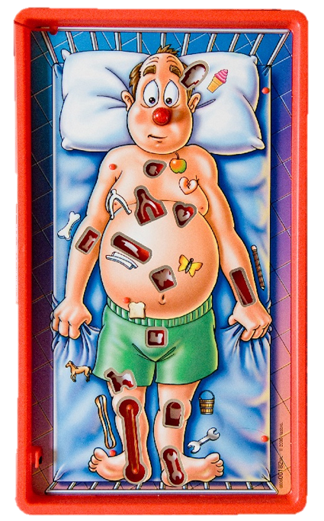
Let’s gather some evidence...
Notes:
Demo:
RDP into instance
Show services running (process explorer)
Reflector the waappagent - D:\Packages\GuestAgent = agent that communicates with FC
GetFabricAddressFromDHCP()
Wireshark communication with FC HOST agent (not FC directly)

Slide 28
Deploying a service
What happens when I click “Upload”?

Slide 29
Service Deployment Steps
Process service model files
Determine resource requirements
Create role images
Allocate compute and network resources
Prepare nodes
Place role images on nodes
Create & start VM
Configure networking
Dynamic IP addresses (DIPs) assigned to blades
Virtual IP addresses (VIPs) + ports allocated
Programs load balancers to allow traffic

Slide 30
Service Resource Allocation
Goals:
Allocate service components to available resources
Satisfy constraints (VM size, fault domains)
Optionally: satisfy soft constraints
Prefer simplified deployments
Instances from same update domain on same host
Optimize networking
Put nodes closer together

Slide 31
Example
Role A
Count: 3
Update Domains: 3
Fault Domains: 3
Size: Large
Role B
Count: 2
Update Domains: 2
Fault Domains: 2
Size: Medium
my.cloudapp.net
LB
10.100.0.36
10.100.0.185
10.100.0.122
Fault Domain 1
Fault Domain 2
Fault Domain 3

Slide 32
Provisioning a Role Instance
FC pushes role files & configuration to host agent
Host agent creates three VHDs:
Differencing VHD for OS image (D:\)
Host agent injects FC guest agent into VHD for Web/Worker roles
Resource VHD for temporary files (C:\)
Role VHD for role files (first available drive letter e.g. E:\, F:\)
Host agent creates VM, attaches VHDs, and starts VM

Slide 33
Provisioning a Role Instance
Guest agent starts role host & calls role entry point
Starts health heartbeat to and gets commands from host agent
Load balancer only routes to external endpoint when it responds to simple HTTP GET (LB probe)

Slide 34
Provisioning VM Role Instances
VM Role base and differencing VHD are stored in Windows Azure Storage blobs
Shadow versions are made when the originals are uploaded
VHD reads all go through a VHD caching service
Reads come on-demand from the cache
Writes go to a secondary differencing VHD
“Reimage” simply deletes it and reboots
VHD Caching
Service
Secondary Differencing VHD
RDFE
Shadow Differencing VHD
Base VHD
Windows Azure Blob Storage
Original Base VHD
Shadow Base VHD
Original Differencing VHD
Shadow Differencing VHD
Node

Slide 35
Let’s get some evidence...
Notes:
Demo:
RDP into instance
Show drives available (C:\, D:\ and E:\)
Have a look at C:\Config
Have a look at the batch files on D:\

Slide 36
Updating a service
What happens when I click “Upgrade”?

Slide 37
VIP Swap Upgrades
Swap Virtual IPs between the two slots
Production becomes Staging
Staging becomes Production
Instances are not affected
DNS and LB remains intact
Happens very fast
Can only use when the service model hasn’t changed

Slide 38
VIP Swap
Deployment
Web Role
Worker Role
VM
VM
Load Balancer:
VM
VM
Prod
Prod
Deployment
Stage
Stage
Web Role
Worker Role
VM
VM
VM
VM

Slide 39
In-Place Upgrades
“Rolling upgrades”
Difficult to do in traditional IT
Leverages Upgrade Domains
Service model must be identical
No new roles, no changes in .csdef, etc.
For Each Upgrade Domain
Stop instances
Update
Start instances

Slide 40
In Place Upgrade
Rack
Rack
Load Balancer
Web Role
Web Role
#1
VM
VM
Prod
#2
VM
VM
Worker Role
Worker Role
#1
VM
VM
#2
VM
VM

Slide 41
Host OS updates
What happens on “patch Tuesday”?

Slide 42
Updating the Host OS
Initiated by the Windows Azure team
Goal: update all machines ASAP not violating SLA
Your role instance keeps the same VM and VHDs, preserving cached data in the resource volume.
Update domains are allocated to 1 host node
Don’t make things confusing
Allows rebooting a complete host without violating SLA
Allows updating all hosts for UDx at once

Slide 43
Health
What happens when nothing happens?

Slide 44
Load Balancer
LB “probes” guest agent every 15 seconds
Miss 2 probes? LB stops forwarding traffic
Role can report “busy” to guest agent
Guest agent stops responding probes
public class WebRole : RoleEntryPoint { public override bool OnStart() { RoleEnvironment.StatusCheck += (sender, args) => { if (DateTime.UtcNow.Second > 20) args.SetBusy(); }; return base.OnStart(); } }

Slide 45
Node Health Index
Based on heartbeats, typically 15 seconds
Used for status and recovery
Health state sampler resets the index on successful poll
Once index falls below zero, FC attempts to heal node
Host agent timeout is 10 minutes
Worst-case reaction time is timeout interval + heartbeat interval
Healthy
Missed
Heartbeats
Recovery
Initiated
Health
Timeout
Node
Health
Index
Missed
Heartbeat
Heartbeat
Interval
Heartbeat
Timeout

Slide 46
Node and Role Health Maintenance
FC maintains service availability by monitoring the software and hardware health
Based primarily on heartbeats
Automatically “heals” affected roles
Problem | How Detected | Fabric Response
Role instance crash | FC guest agent monitors role termination | FC restarts role
Guest VM or agent crash | FC host agent notices missing guest agent heartbeats | FC restarts VM and hosted role
Host OS or agent crash | FC notices missing host agent heartbeat | Tries to recover node FC reallocates roles to other nodes
Detected node hardware issue | Host agent informs FC | FC migrates roles to other nodes Marks node “out for repair”

Slide 47
Guest Agent and Role Instance Heartbeats and Timeouts
Guest Agent Heartbeat
5s
Guest Agent Heartbeat Timeout
10 min
25 min
Guest Agent
Guest
Agent Connect
Timeout
Role Instance Heartbeat
15s
Role Instance “Unresponsive” Timeout
30s
Load Balancer Heartbeat
15s
Load Balancer
Timeout
30s
Indefinite
15 min
Role Instance
Role
Instance Launch
Role
Instance Start
Role
Instance Ready
(for updates only)

Slide 48
The cascade
Fabric Controller
Host Agent
Guest Agent
Your application
Datacenter level
Host level
VM level
Application
Load Balancer

Slide 49
Moving a Role Instance (Healing)
Similar to a service update
Source node:
Role instances stopped
VMs stopped
Node reprovisioned
Destination node:
Same steps as initial role instance deployment
Warning: Resource VHD is not moved
(that’s why you should consider it volatile)

Slide 50
Takeways
What to remember?

Slide 51
Takeaways
Windows Azure & PaaS
The Fabric Controller
Deploying a service
Updating a service
Host OS upgrades
Health

Slide 52
THANK YOU
Maarten Balliauw http://about.me/maartenballiauw http://blog.maartenballiauw.be @maartenballiauw

